Slide 1
CREDIT EDA CASE STUDY
By Anuj Grover

Slide 2
Finding Outliers

Slide 3
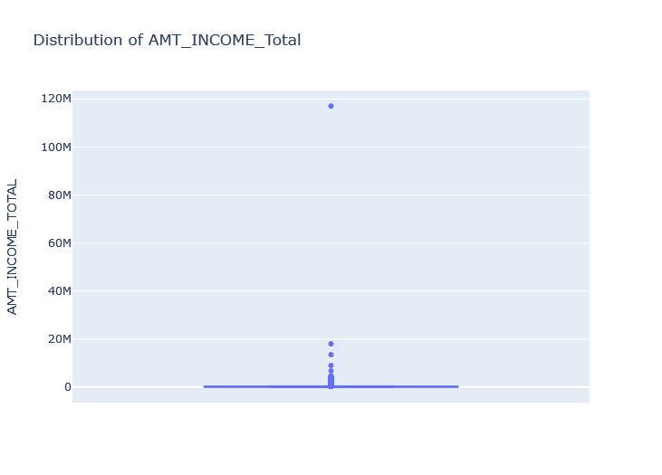
Outlier is data/objects that deviates significantly from rest of the objects. here we can see in graph 'AMT_INCOME_TOTAL' 117M is an Outlier

Slide 4
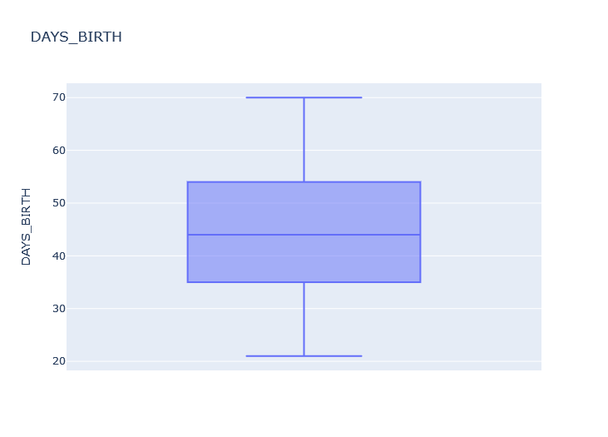
Here in the graph 'DAYS_BIRTH' we don’t find any outlier

Slide 5
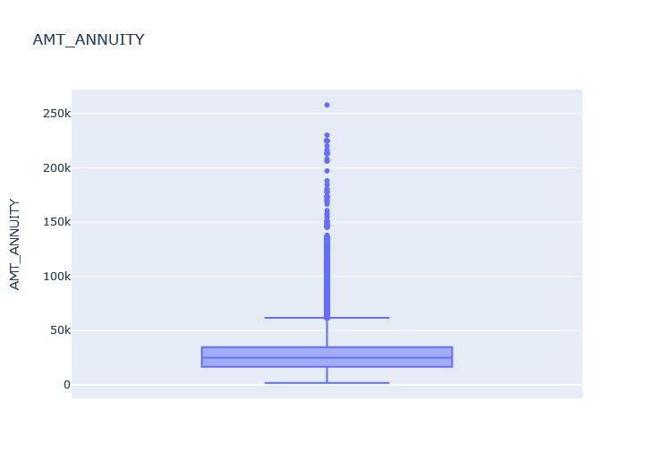
Here we can see that in graph 'AMT_ANNUITY' we observe that there is a value of 258.0255k is an outlier

Slide 6
Dividing the data set into two different data set based upon 'Target' value.

Slide 7
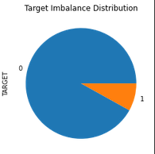
Here in the Pie chart we can see that Defaulter are having 8% Approx. and Non defaulter are containing 92% Approx.

Slide 8
Univariate Analysis

Slide 9
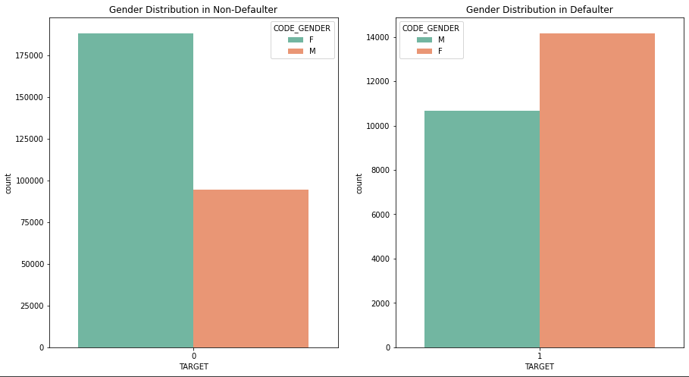
In both the charts female had applier higher then the male clients for loan

Slide 10
Univariate Analysis with respect to target variable

Slide 11
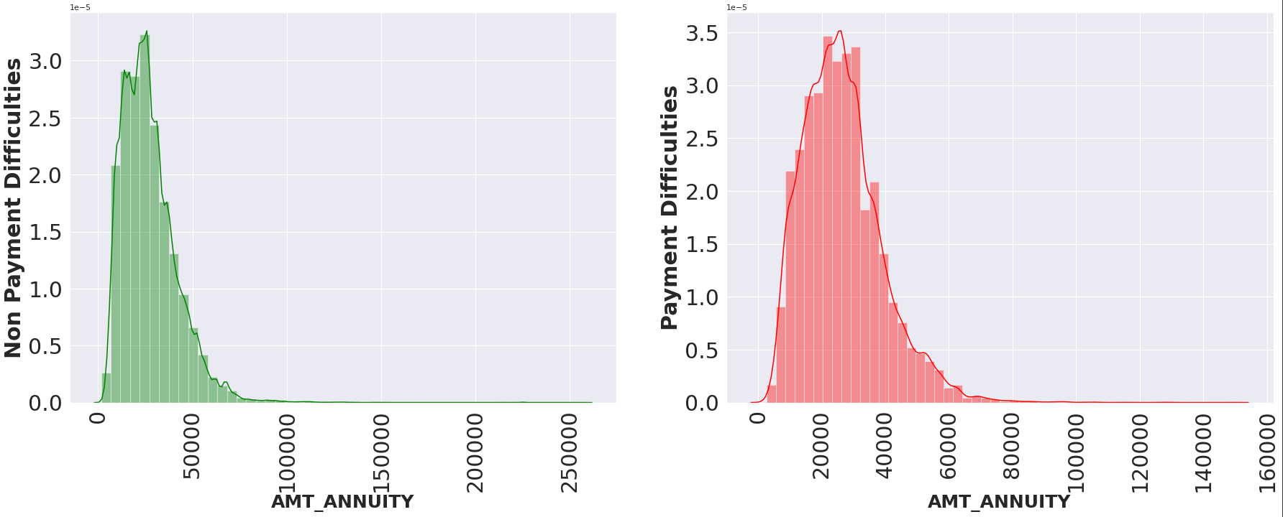

Slide 12
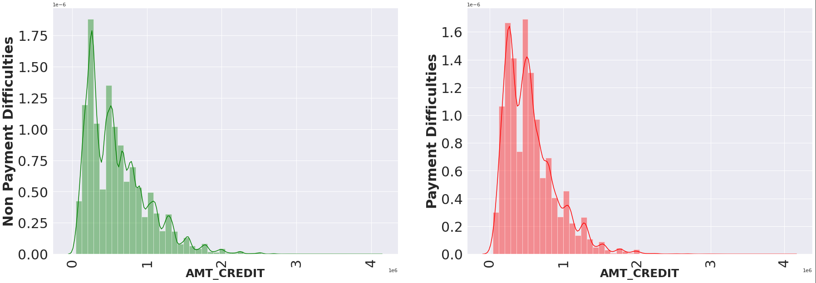

Slide 13
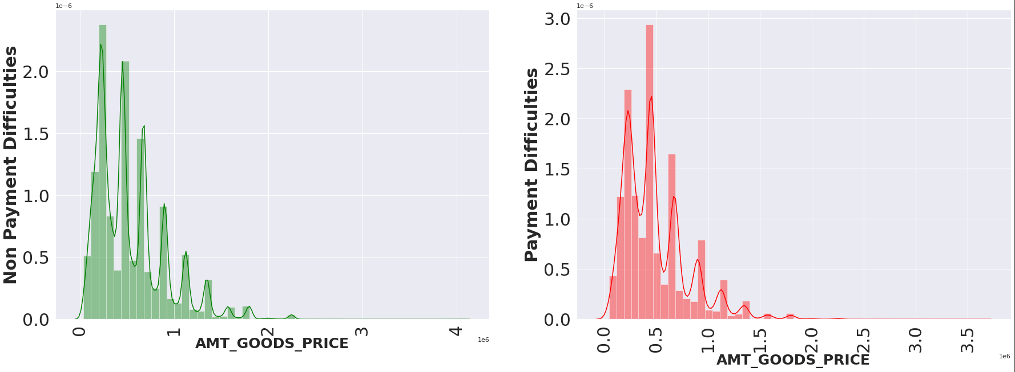

Slide 14
- People with df_1 has largely staggered income as compared to df_0 - These plots are highlighting that people who have difficulty in paying back loans with respect to their income. - Dist. Plot highlights the curve shape which is wider for df_1 in comparison to df_0 which is narrow.

Slide 15
Bivariate Analysis

Slide 16
Income amount Vs Education Status Vs family status For target Non-Defaulter

Slide 17
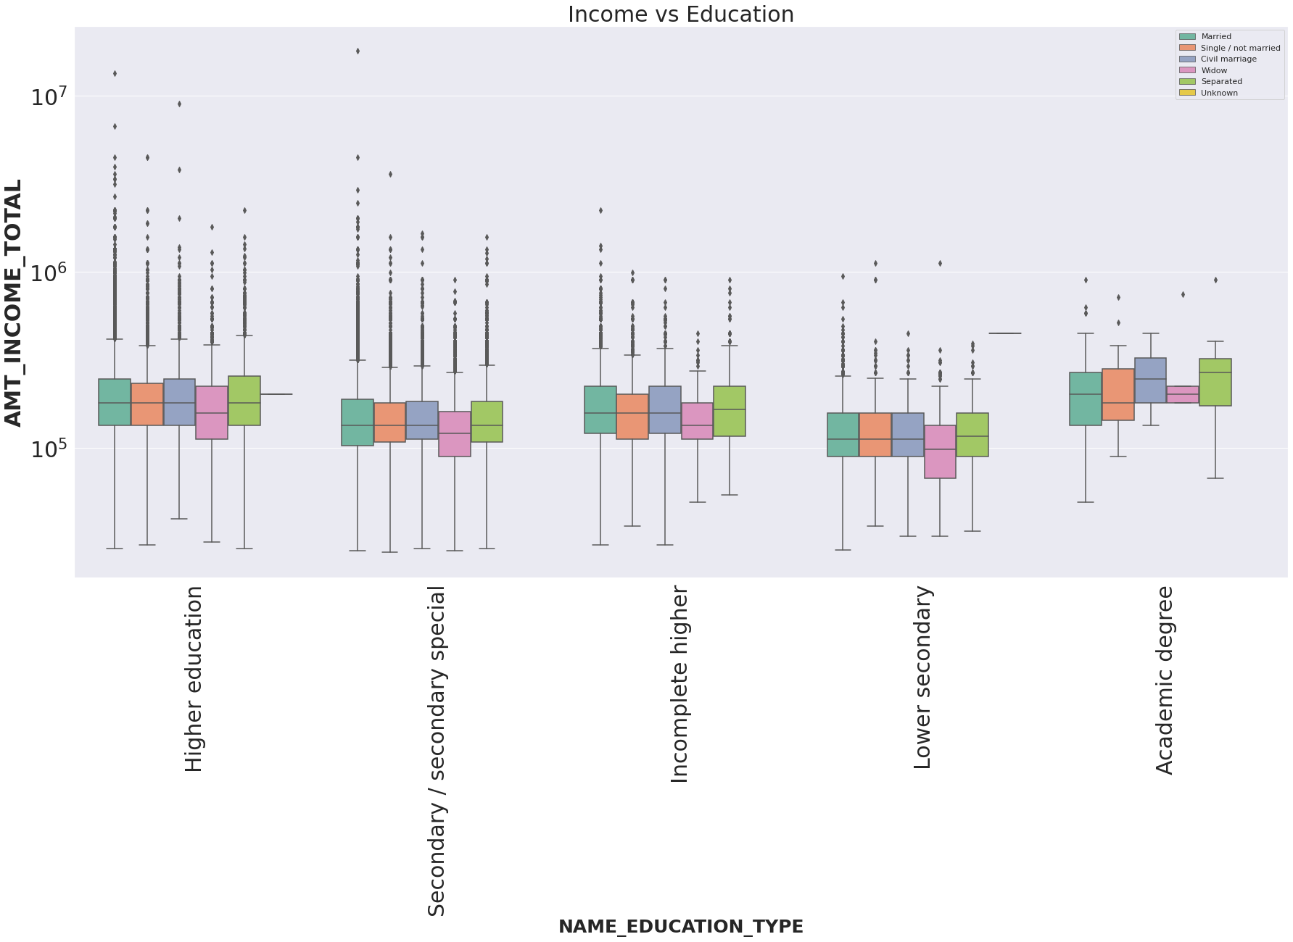

Slide 18
From the above graph we can see that Clients having higher Education, Incomplete Higher Education, Lower Secondary Education And Secondary/Secondary special have a higher number of outliers

Slide 19
Distribution of income range and the category with maximum loan-payment difficulties

Slide 20
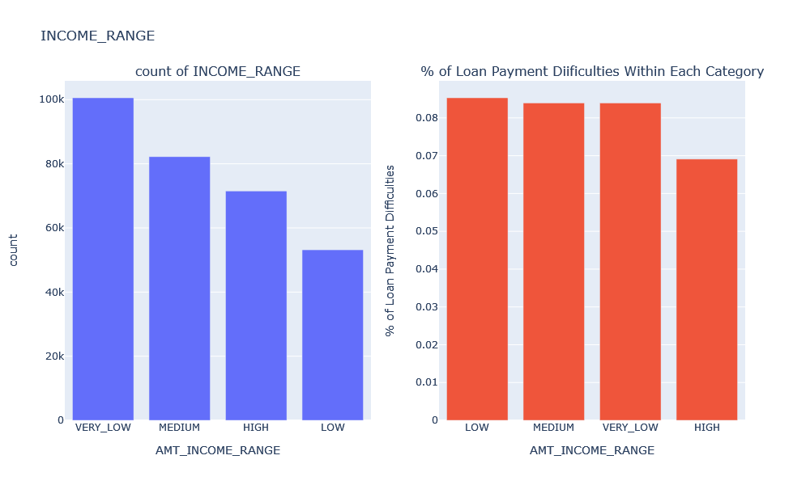
From the above plot we can clearly seen that people with income range 'LOW' have maximum percentage of loan payment difficulties

Slide 21
Distribution of income range and the Category with maximum loan-difficulties

Slide 22
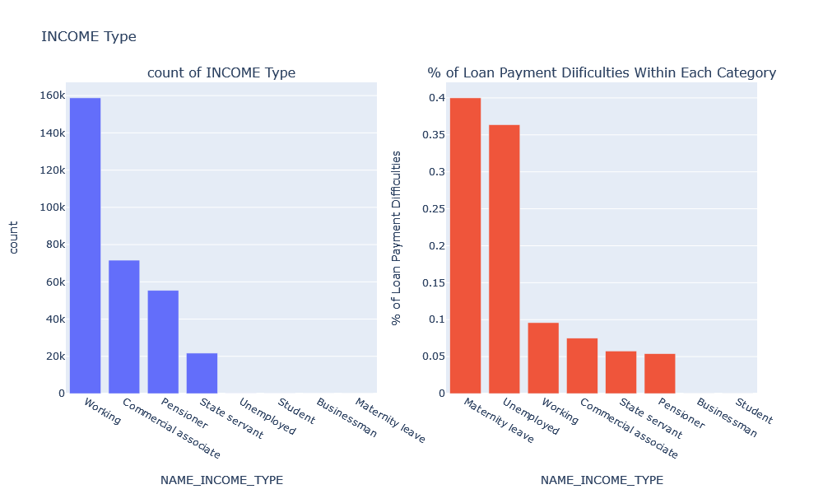
from the above plot we can clearly seen that clients with 'Maternity leave' income type are having maximum percentage of loan payment difficulties

Slide 23
Conclusion

Slide 24
- Bank should target more on Male clients as their number are less than female. - Bank should less focus on 'working' as they are having most number of unsuccessful payment - Business decision is made to minimize the risk for giving loan to defaulter people - Business decision made how to give loan to people who are credit worthy - Bank should target more on Male clients as their number are less than female.

Slide 25
Thank You

